Slide 1
Presentation
Jiayu Chen
2024.04.22

Slide 2
Outline
Part_1: Heartbeat Simulator
Part_2: Paper Writing

Slide 3
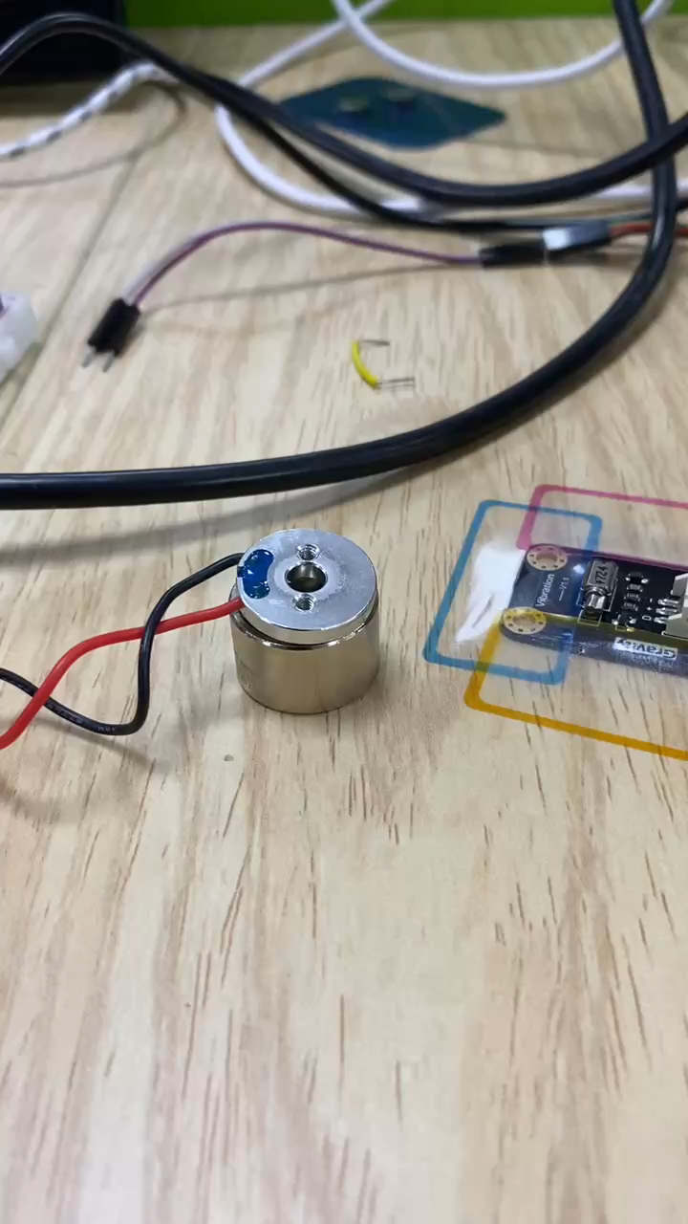
Heartbeat Simulator
GPIO_A.HIGH
GPIO_B.LOW
GPIO_A.LOW
GPIO_B.HIGH
The version I sent you earlier is unstable and may not respond when plugged in. This is because I used Raspberry Pi GPIO pins to switch voltage polarity. The GPIO pins of the Pi have weak current output.
The next version: Instead of using GPIO pins to directly change the power source, I'll supply power with a voltage of 5.5 amps. Additionally, I've designed a circuit using transistors to invert the voltage polarity.
We'll have to wait until tomorrow to try it out when the transistors arrive.

Slide 4
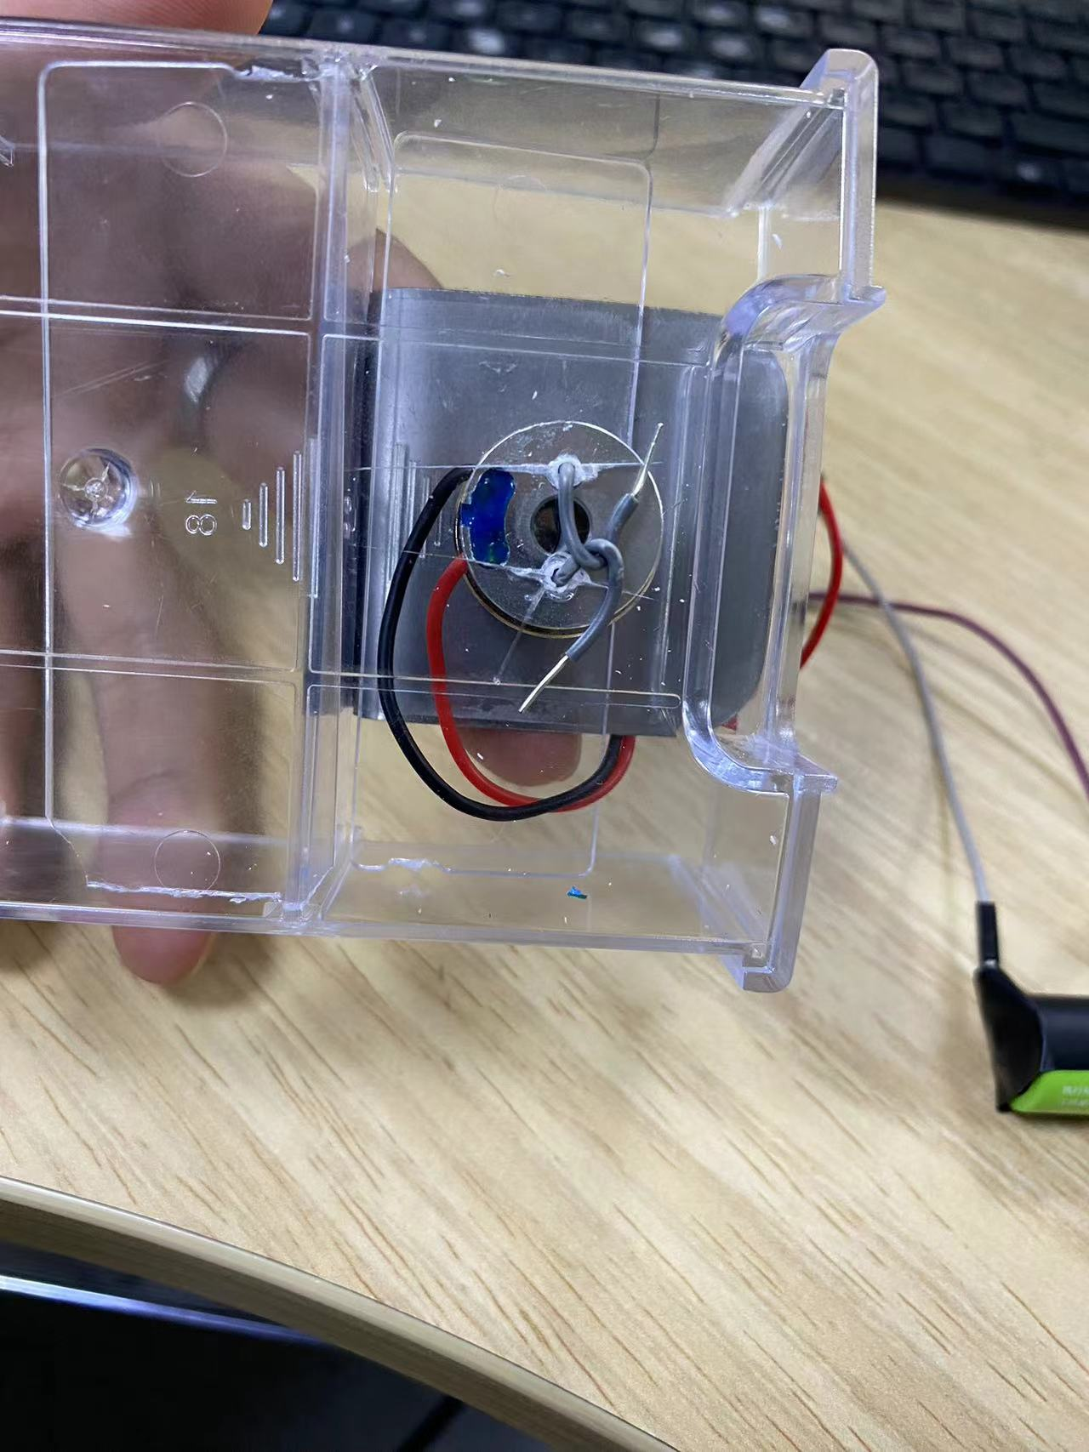
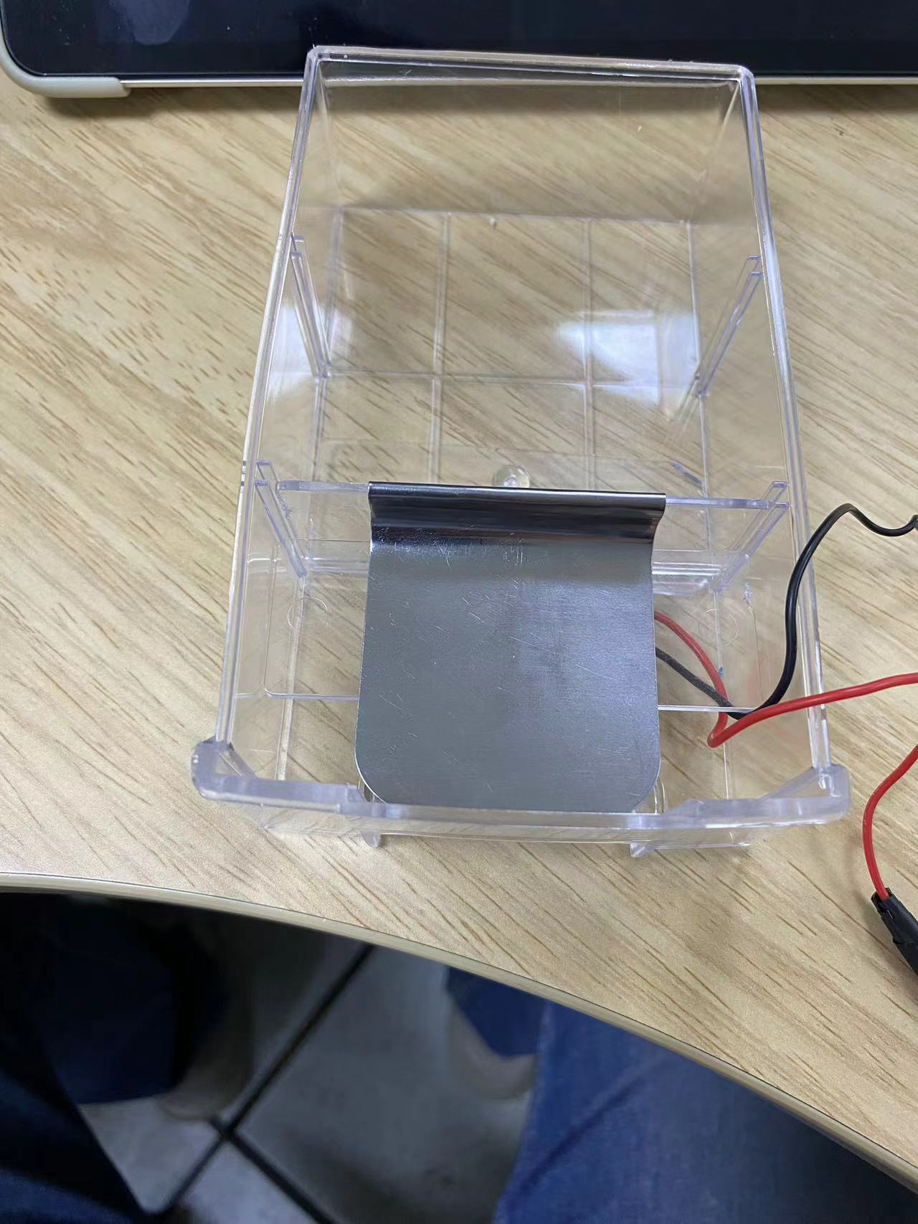
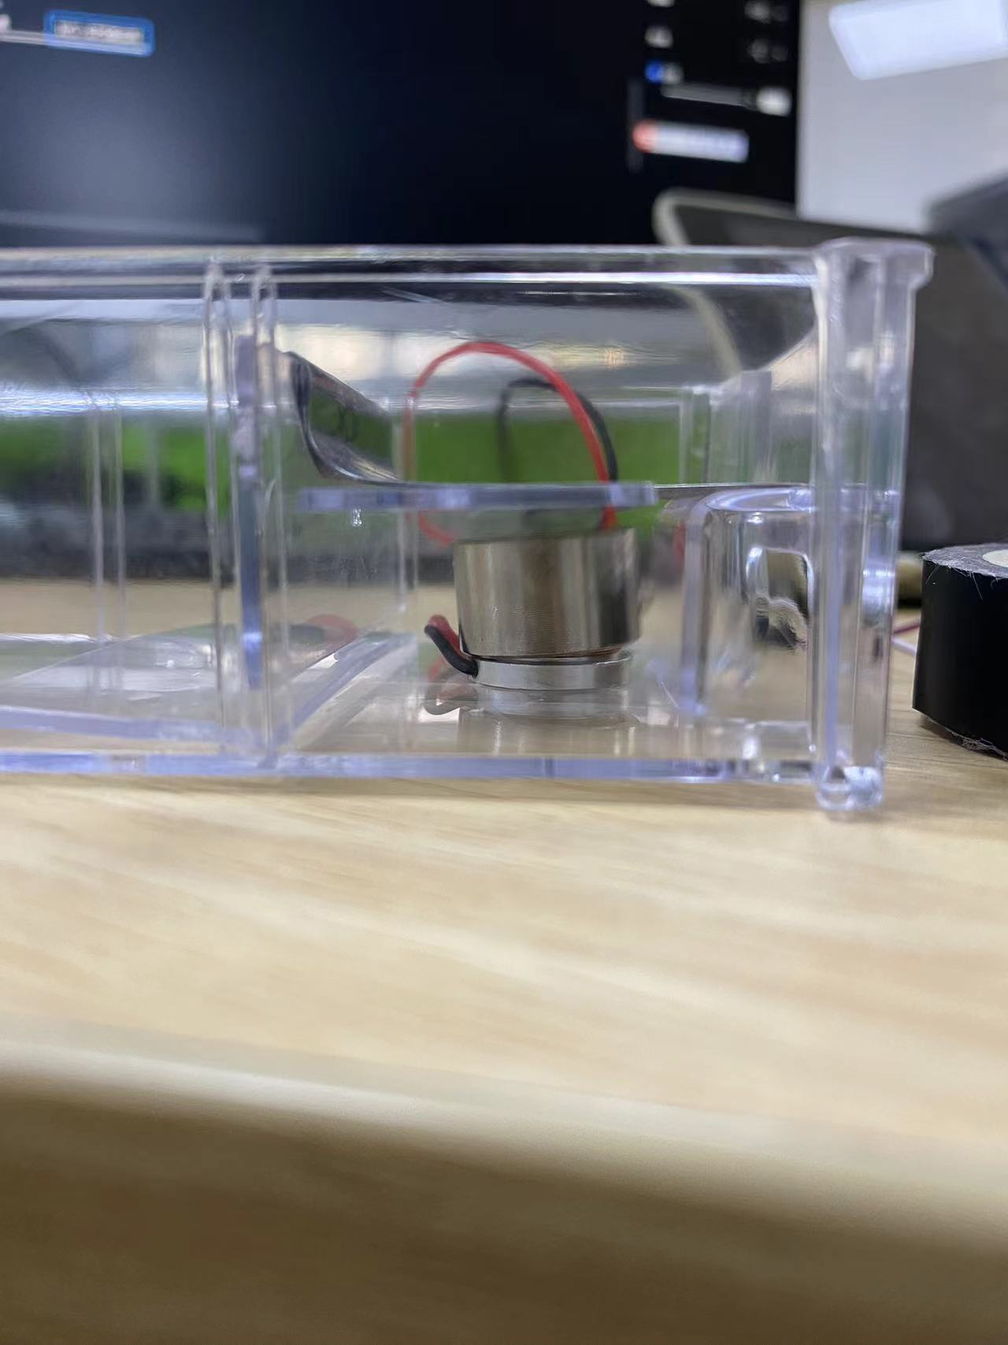
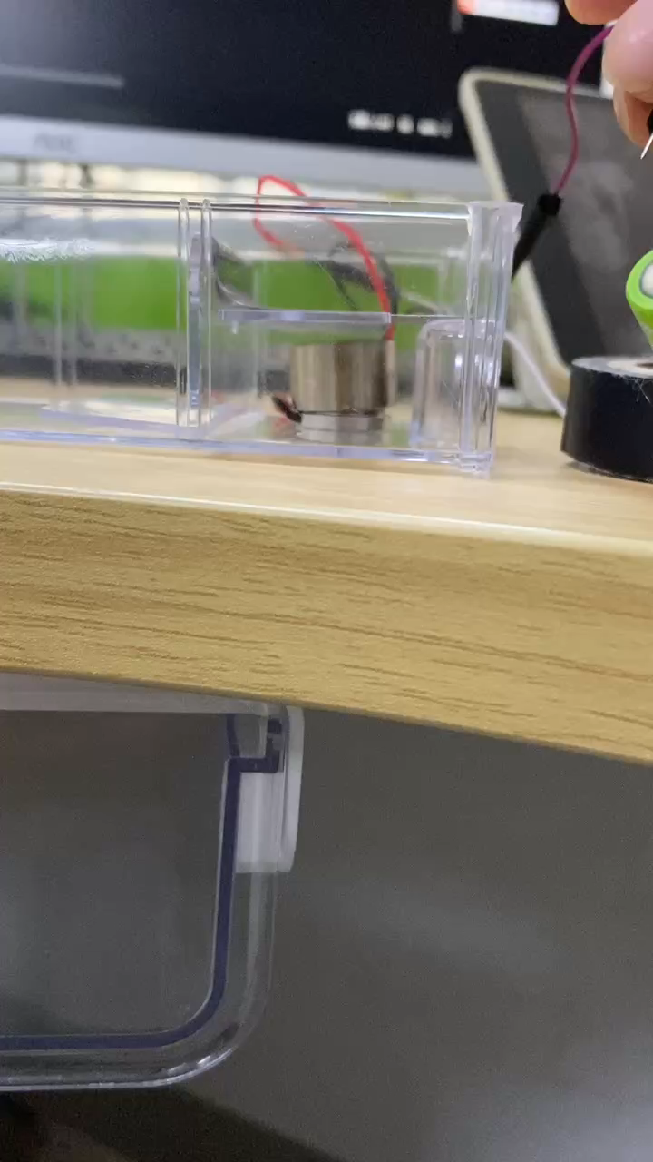
Heartbeat Simulator
I designed a box to fix the motor, but it's still a bit loose, causing some additional vibration. I'll need to use double-sided tape at the back to secure it properly.
Back
Top
Side
Video

Slide 5
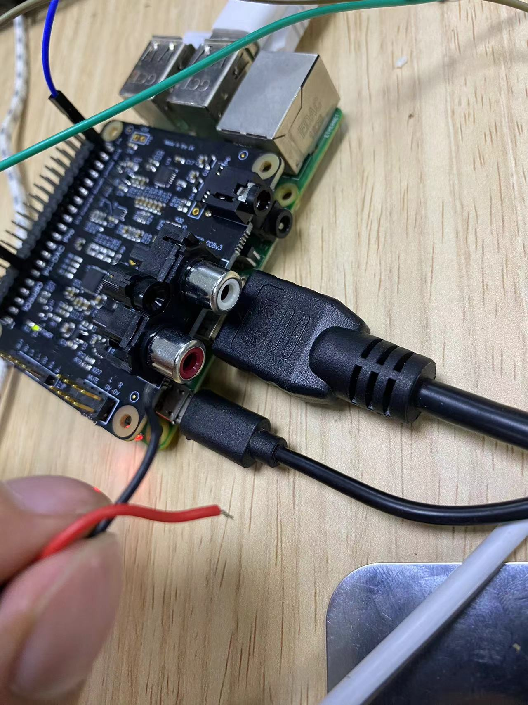
Heartbeat Simulator
I'm still struggling with how to use the DAC board.
I don’t know how to call this DAC board’s interface on the Raspberry Pi or how to connect the I2S port to the wires and control the motor.

Slide 6
Paper Writing
Progress:
The experimental results and analysis for irregular heart rhythms haven't been written yet (it will take a full day after collecting the data).
When the transistors arrive, I will build next version’s heartbeat simulator as soon as possible.
The paper has been largely revised based on your and Yingjian's suggestions. I should be able to thoroughly revise it again according to your guidance by the end of tomorrow.

Slide 7
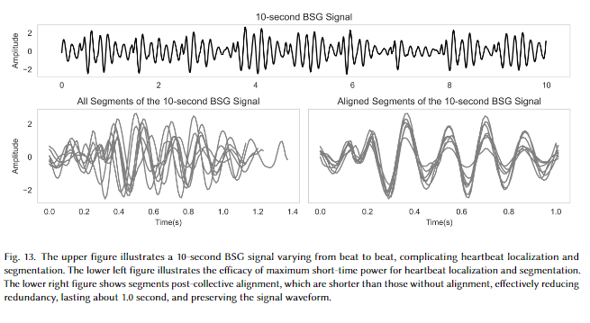
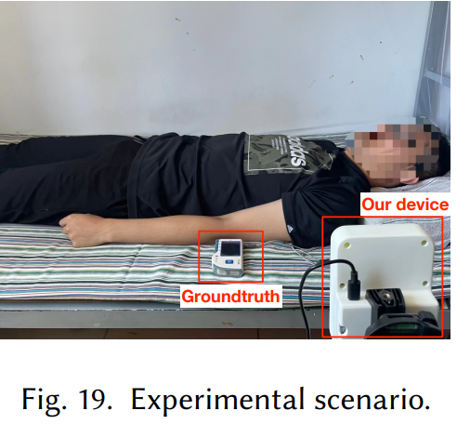
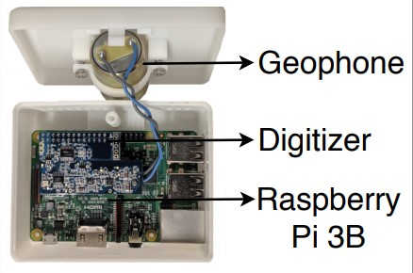
Paper Writing
Questions:
How to describe the irregular heartbeats? Arrhythmia, irregular heartbeats or irregular heart rhythms.
Two photos are needed.
Figures.
Authors of Paper is okay?: Jiayu Chen, Yida Zhang, Yingjian Song, Junzhou Chen, Zaipeng Xie, Xiang Zhang, Qin Lu, Wenzhan Song

